Slide 1




CMSC 125: Operating Systems
Instructor: Joseph Anthony C. Hermocilla
Email: jchermocilla@up.edu.ph
Web: https://jachermocilla.org

Slide 2

Resources
Book: https://pages.cs.wisc.edu/~remzi/OSTEP/
Slides Template:
https://pages.cs.wisc.edu/~remzi/OSTEP/Educators-Slides/Youjip/

Slide 3
Acknowledgement
This lecture slide set was initially developed for Operating System course in Computer Science Dept. at Hanyang University. This lecture slide set is for OSTEP book written by Remzi and Andrea at University of Wisconsin.

Slide 4
43. Log-structured File Systems
Operating System: Three Easy Pieces

Slide 5
LFS: Log-structured File System
Memory sizes were growing.
Large gap between random IO and sequential IO performance.
Existing File System perform poorly on common workloads.
File System were not RAID-aware.

Slide 6
Writing to Disk Sequentially
How do we transform all updates to file-system state into a series of sequntial writes to disk?
data update
metadata needs to be updated too. (Ex. inode)
 | D
A0
 | D | I
blk[0]:A0
A0

Slide 7
Writing to Disk Sequentially and Effectively
Writing single blocks sequentially does not guarantee efficient writes
After writing into A0, next write to A1 will be delayed by disk rotation
Write buffering for effectiveness
Keeps track of updates in memory buffer (also called segment)
Writes them to disk all at once, when it has sufficient number of updates.
blk[0]:A0
blk[0]:A1
blk[0]:A2
blk[0]:A3
 | D[j,0] | D[j,1] | D[j,2] | D[j,3] |  | D[k,0]
blk[0]:A5
A0
A1
A2
A3
inode[j]
A5
inode[k]

Slide 8
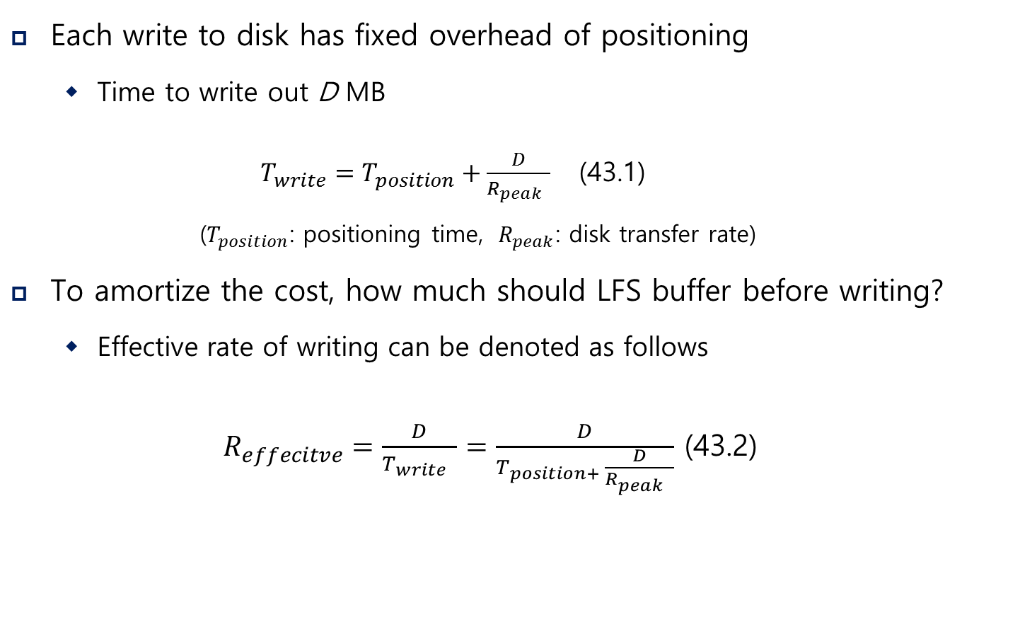
How Much to Buffer?
Each write to disk has fixed overhead of positioning
Time to write out D MB
$T_{write}=T_{position}+\frac{D}{R_{peak} }$ (43.1)
($T_{position}$: positioning time, ${ R}_{peak}$: disk transfer rate)
To amortize the cost, how much should LFS buffer before writing?
Effective rate of writing can be denoted as follows
$R_{effecitve}=\frac{D}{T_{write} }=\frac{D}{T_{position+ }\frac{D}{R_{peak} }}$ (43.2)

Slide 9
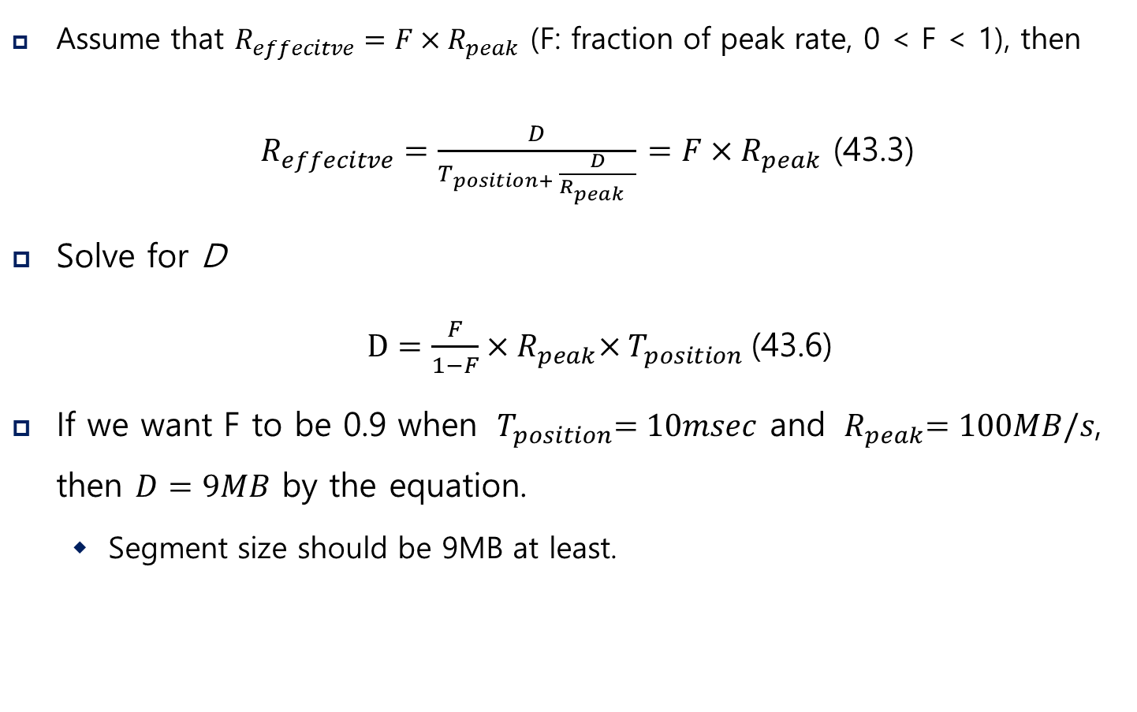
How Much to Buffer?
Assume that $R_{effecitve}=F×R_{peak}$ (F: fraction of peak rate, 0 < F < 1), then
$R_{effecitve}=\frac{D}{T_{position+ }\frac{D}{R_{peak} }}$ $=F×R_{peak}$ (43.3)
Solve for D
$D=\frac{F}{1−F}×{ R}_{peak}×{ T}_{position}$(43.6)
If we want F to be 0.9 when ${ T}_{position}=10msec$ and ${ R}_{peak}=100MB/s$, then $D=9MB$ by the equation.
Segment size should be 9MB at least.

Slide 10
Finding Inode in LFS
Inodes are scattered throughout the disk!
Solution is through indirection “Inode Map” (imap)
LFS place the chunks of the inode map right next to where it is writing all of the other new new information
blk[0]:A0
map[k]:A1
 | D | I[k] | imap
A0
A1

Slide 11
The Checkpoint Region
How to find the inode map, spread across the disk?
The LFS File system have fixed location on disk to begin a file lookup
Checkpoint Region contains pointers to the latest of the inode map
Only updated periodically (ex. Every 30 seconds) → performance is not ill-affected
blk[0]:A0
map[k]:A1
CR |  | D | I[k] | imap
imap
[k..k+N]:
A2
0
A0
A1
A2

Slide 12
Reading a File from Disk: A Recap
Read checkpoint region
Read entire inode map and cache it in memory
Read the most recent inode
Read a block from file by using direct or indirect or doubly-indirect pointers

Slide 13
What About Directories?
Directory structure of LFS is basically identical to classic UNIX file systems.
Directory is a file which data blocks consist of directory information
blk[0]:A0
(foo,k)
blk[0]:A2
map[k]:A1
map[dir]:A3
 | D[k] | I[k] | D[dir] | I[dir] | imap
A0
A1
A2
A3

Slide 14
Garbage Collection
LFS keeps writing newer version of file to new locations.
Thus, LFS leaves the older versions of file structures all over the disk, call as garbage.

Slide 15
Examples: Garbage
For a file with a singe data block
Overwrite the data block: both old data block and inode become garbage
Append a block to that original file k: old inode becomes garbage
blk[0]:A0
blk[0]:A4
 | D0 | I[k] |  | D0 | I[k]
A0
(both garbage)
A4
blk[0]:A0
blk[0]:A0
blk[1]:A4
 | D0 | I[k] |  | D1 | I[k]
A0
(garbage)
A4

Slide 16
Handling older versions of inodes and data blocks
One possibility: Versioning file system
keep the older versions around
Users can restore old file versions
LFS approach: Garbage Collection
Keep only the latest live version and periodically clean old dead versions
Segment-by-segment basis
Block-by-block basis cleaner eventually make free holes in random location → Writes can not be sequential anymore

Slide 17
Determining Block Liveness
Segment summary block (SS)
Located in each segment
Inode number and offset for each data block are recorded
Determining Liveness
The block is live if the latest inode indicates the block
Version number can be used for efficient liveness determining
blk[0]:A0
map[k]:A1
A0: (K,0) SS | D | I[k] | imap
A0
A1

Slide 18
Which Blocks to Clean, and When?
When to clean
Periodically
During idle time
When the disk is full
Which blocks to clean
Segregate hot/cold segments
Hot segment: frequently over-written → more blocks are getting over-written if we wait a long time before cleaning
Cold segment: relatively stable → May have a few dead blocks, but the other blocks are stable
Clean cold segment sooner and hot segment later

Slide 19
Crash Recovery and the Log
Log organization in LFS
CR points to a head and tail segment
Each segment points to next segment
LFS can easily recover by simply reading latest valid CR
The latest consistent snapshot may be quite old
To ensuring atomicity of CR update
Keep two CRs
CR update protocol: timestamp → CR → timestamp
Roll forward
Start from end of the log (pointed by the lastest CR)
Read next segments and adopt any valid updates to the file system

